Slide 1
PART 2 Testing Fundamentals

Slide 2
Agenda

Slide 3
1. Static White-Box Testing: Examining the Design and Code
2. Formal Reviews
3. Coding Standards and Guidelines
4. Generic Code Review Checklist

Slide 4

1. Static White-Box Testing: Examining the Design and Code

Slide 5
2. Formal Reviews

Slide 6
2. Formal Reviews
a. four essential elements
  Identify Problems
  Follow Rules
  Prepare
  Write a Report

Slide 7
2. Formal Reviews
b. a few indirect results
  Communications
  Quality
  Team Camaraderie
  Solutions

Slide 8
2. Formal Reviews
c. Method
  Desk Checking
  Peer Reviews
  Walkthroughs
  Inspections

Slide 9
3. Coding Standards and Guidelines
a. Reasons
  Reliability
  Readability/Maintainability
  Portability

Slide 10
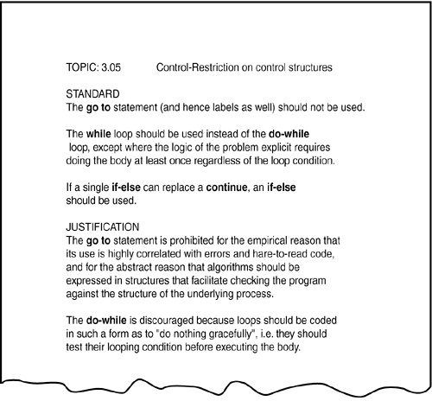
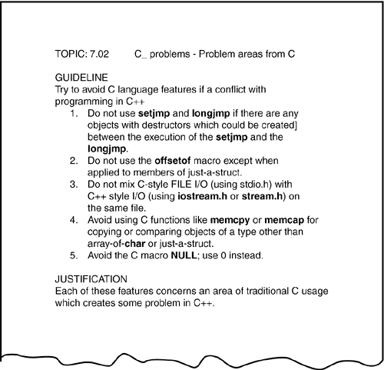
3. Coding Standards and Guidelines

Slide 11
3. Coding Standards and Guidelines
c. Resources
  American National Standards Institute (ANSI), www.ansi.org
  International Engineering Consortium (IEC), www.iec.org
  International Organization for Standardization (ISO), www.iso.ch
  National Committee for Information Technology Standards (NCITS), www.ncits.org
  Association for Computing Machinery (ACM), www.acm.org
  Institute of Electrical and Electronics Engineers, Inc (IEEE), www.ieee.org

Slide 12
4. Generic Code Review Checklist
  Data Reference Errors
  Data Declaration Errors
  Computation Errors
  Comparison Errors
  Control Flow Errors
  Subroutine Parameter Errors
  Input/Output Errors
  Other Checks

Slide 13
1. Static White-Box Testing: Examining the Design and Code
2. Formal Reviews
3. Coding Standards and Guidelines
4. Generic Code Review Checklist

Slide 14
TASK:
1. 对一段代码做静态检查。

